Slide 1






Recursive sequences
Définition
A sequence is said to be recursive if the sequence is
definied as follows
The function is defined on or on a subset $I$of .

Slide 2
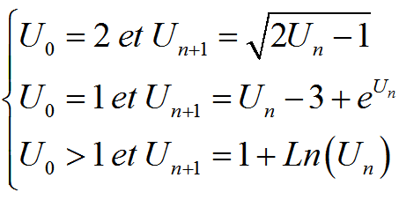
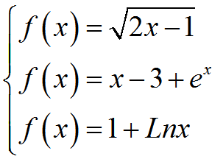
Recursive sequences
The functions associated to the sequences are

Slide 3

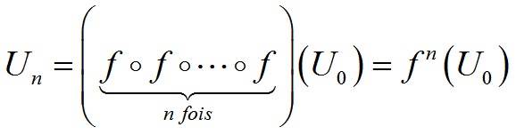
Recursive sequences
The terms of a recursive sequence are given as follows :
We can generalize

Slide 4




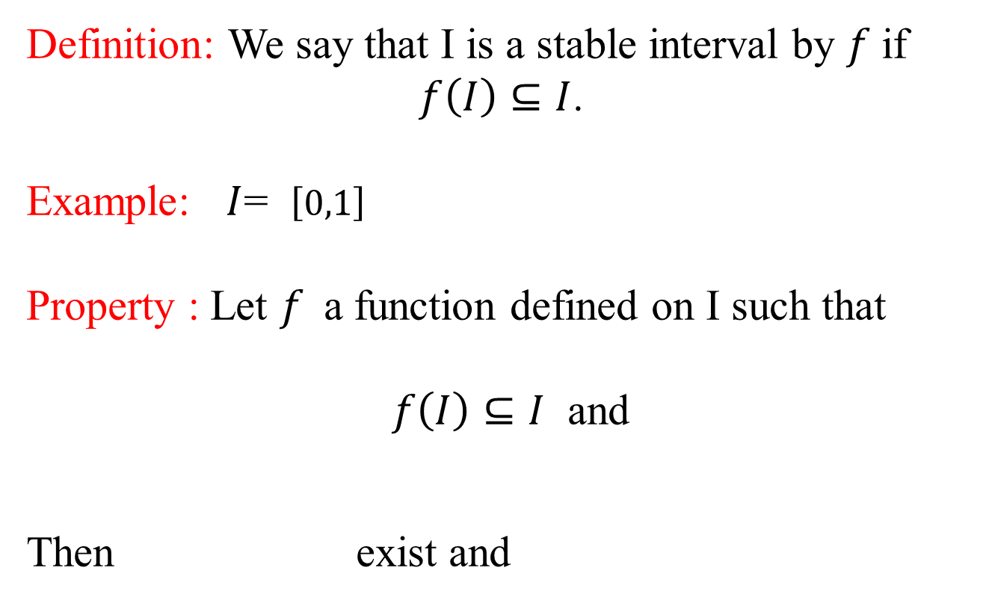
Recursive sequences
Definition: We say that I is a stable interval by $f$if
$f\left(I\right)⊆I$.
Example: $I$= $\left[0,1\right]$
Property : Let $f$a function defined on I such that
$f\left(I\right)⊆I$ and
Then exist and

Slide 5




Recursive sequences
Example
Consider such that
Let . We have $f(\left[0,1\right])⊆\left[0,1\right].$
As , from the preceding property
$∀n∈ℕ, U_{n}$ exists and $U_{n}∈[0,1]$

Slide 6


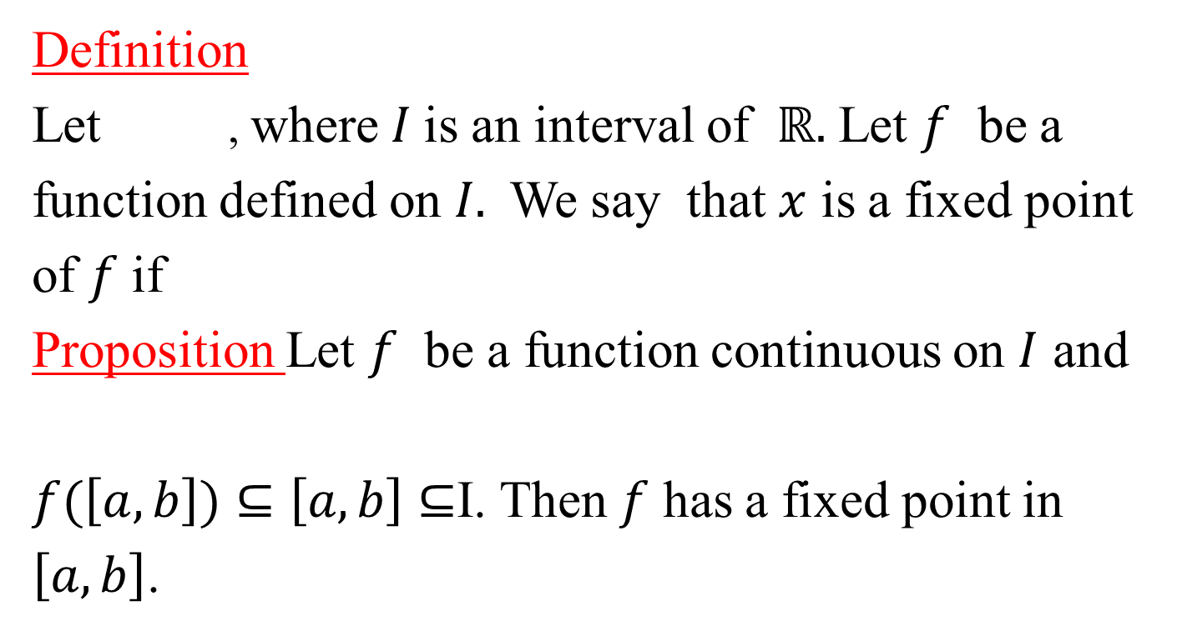
Recursive sequences
Definition
Let , where $I$is an interval of $ℝ.$ Let $f$ be a
function defined on $I.$We say that $x$ is a fixed point
of $f$ if
Proposition Let $f$ be a function continuous on $I$ and
$f(\left[a,b\right])⊆\left[a,b\right]$ $⊆$I. Then $f$ has a fixed point in
$\left[a,b\right]$.

Slide 7



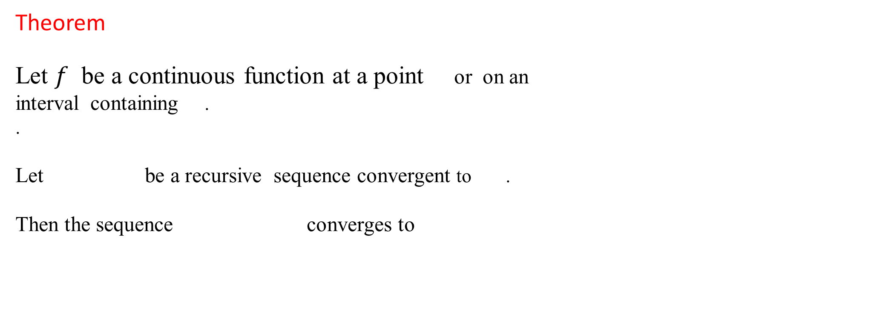
Recursive sequences
Theorem
Let $f$ be a continuous function at a point or on an
interval containing .
.
Let be a recursive sequence convergent to .
Then the sequence converges to

Slide 8

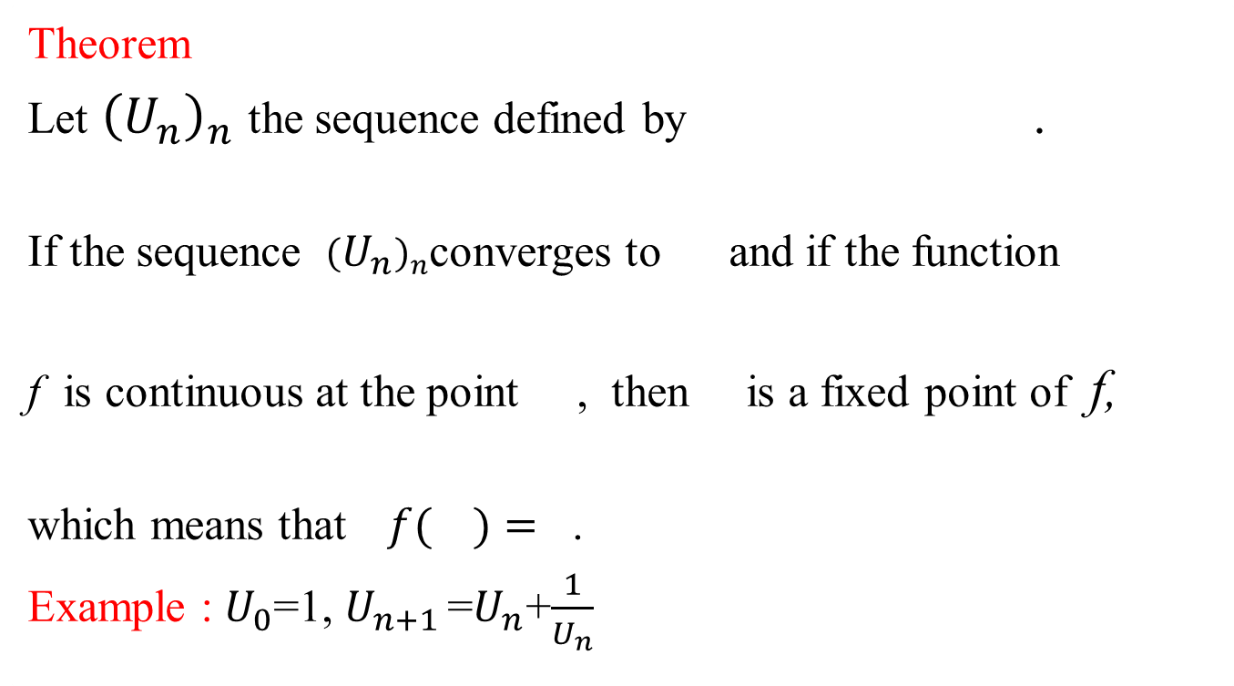
Recursive sequences
Theorem
Let ${\left(U_{n}\right)}_{n}$ the sequence defined by .
If the sequence ${\left(U_{n}\right)}_{n}$converges to and if the function
f is continuous at the point , then is a fixed point of f,
which means that $f( )=$ .
Example : $U_{0}$=1, $U_{n+1 }$=$U_{n}$+$\frac{1}{U_{n}}$

Slide 9




Recursive sequences
Theorem
Let a recursive sequence such that
1) If is increasing then the sequence is
monotone.
is increasing if
is decreasing if

Slide 10
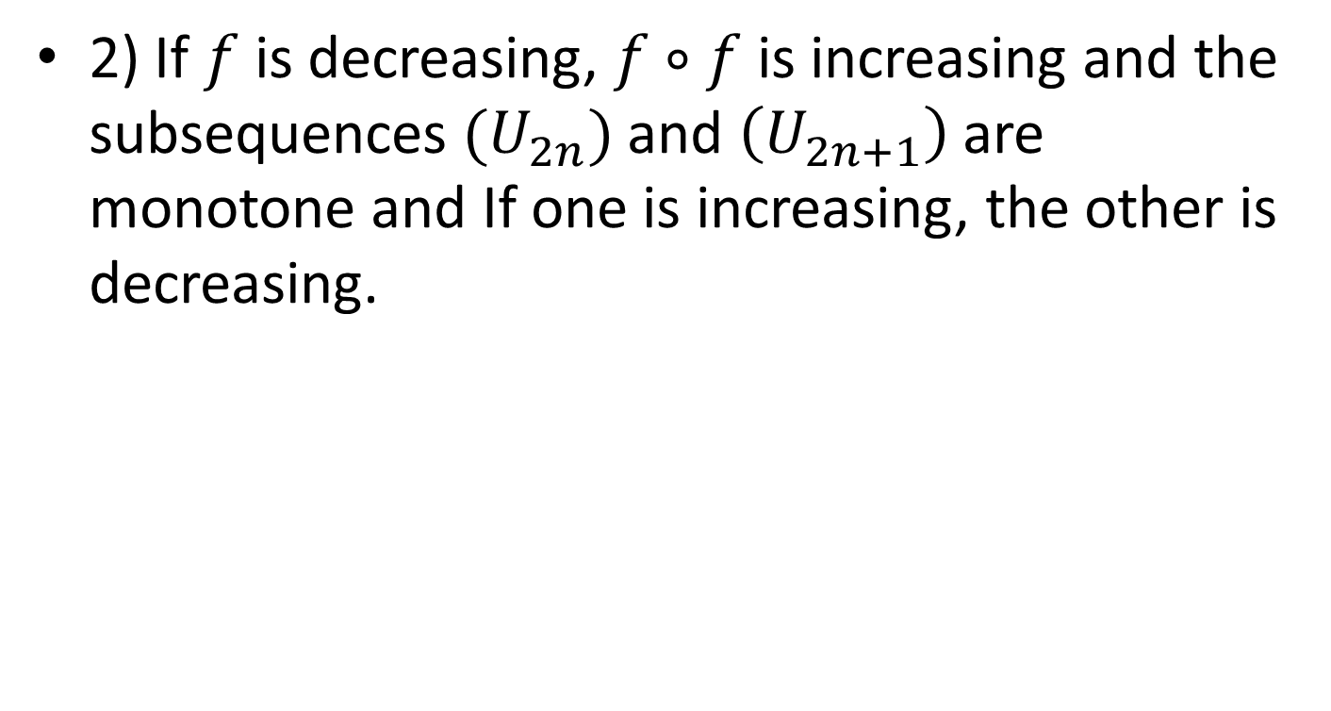
Recursive sequences
2) If $f$ is decreasing, $f∘f$ is increasing and the subsequences $(U_{2n})$ and $\left(U_{2n+1}\right)$are monotone and If one is increasing, the other is decreasing.

Slide 11

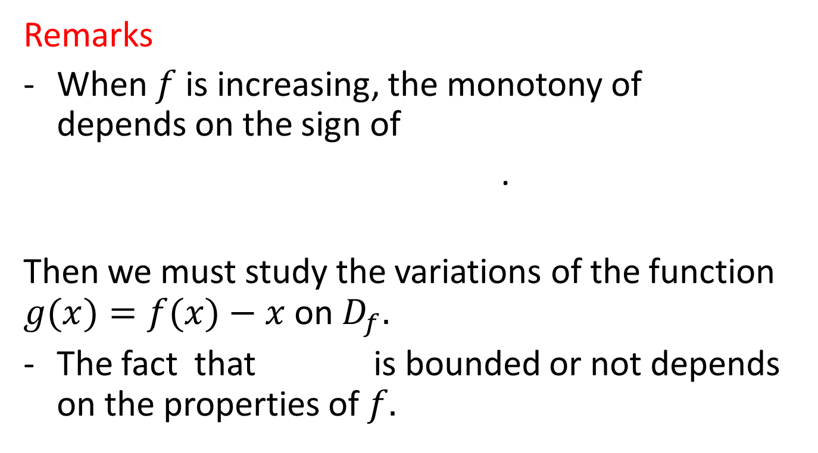
Recursive sequences
Remarks
When $f$ is increasing, the monotony of depends on the sign of
.
Then we must study the variations of the function $g(x)=f(x)−x$on $D_{f}.$
The fact that is bounded or not depends on the properties of $f.$

Slide 12



Recursive sequences
Example
Let such that
Show that
Study the monotony of the sequence
Show that the sequence is convergent

